Slide 1
OIPE-2012, Ghent Overview of oral contributions
P. Di Barba
University of Pavia, Italy

Slide 2
Overview of oral contributions
Accepted papers vs year Oral vs poster presentation

Slide 3
Multi-Level Optimization Methods
Introduction
ANTENNA DESIGN USING VARIABLE-FIDELITY ELECTROMAGNETIC SIMULATIONS | RADIAL OUTPUT SPACE MAPPING FOR ELECTRO-MECHANICAL DESIGN | MULTI-LEVEL DESIGN OF AN ISOLATION TRANSFORMER USING COLLABORATIVE OPTIMIZATION | N-LEVEL OUTPUT SPACE MAPPING TECHNIQUES FOR ELECTROMAGNETIC DESIGN OPTIMIZATION

Slide 4
Multi-Level Optimization Methods
ANTENNA DESIGN USING VARIABLE-FIDELITY ELECTROMAGNETIC SIMULATIONS
Method: Shape-Preserving Response Prediction (SPRP).
The surrogate R_{s} at the current iteration is obtained by aligning low-fidelity model R_{c} with high-fidelity model R_{f} using R_{f} data accumulated in previous iterations. The choice of low-fidelity model is a key issue for the success of the surrogate-base optimization algorithm.
Direct problem solution is based on either full-wave equations or Helmholtz equations.
Coarse model: coarse mesh, fine model: fine mesh
Application: coax-fed microstrip antenna.
Adaptively adjusted design specifications
Commercial FEM software usually contains conventional optimization tools, but does not incorporate multilevel techniques

Slide 5
Multi-Level Optimization Methods
RADIAL OUTPUT SPACE MAPPING FOR ELECTROMECHANICAL DESIGN
Method: Radial Output Space Mapping (ROSM).
The region of interest is progressively constructed through an iterative process using the responses of both fine and coarse models. The residual function between the responses of the two models is defined as a linear combination of Gaussian radial basis function.
Direct problem solution is based on reluctance net:
Coarse model: reluctance network, Fine model: reluctance network
Application: axial flux synchronous machine for electric vehicles: minimize energy loss of a vehicle over a given driving cycle
Rotor 1
N
Z
N
Z
N
Z
Rotor 2

Slide 6
Multi-Level Optimization Methods
MULTI-LEVEL DESIGN OF AN ISOLATION TRANSFORMER USING COLLABORATIVE OPTIMIZATION
Method: Output Space Mapping (OSM)
The use of the OSM technique is proposed for handling the disciplinary optimizations of a collaborative optimization scheme; this way, the accuracy of 3D FEA is exploited at the disciplinary level, with a reasonable computational cost.
Direct problem solution is based on both circuit model and field model
Coarse model: analytical; Fine model: 3D FEM
Application: safety isolation transformer.

Slide 7
Multi-Level Optimization Methods
N-LEVEL OUTPUT SPACE MAPPING TECHNIQUES FOR ELECTROMAGNETIC DESIGN OPTIMIZATION
Method: Output Space Mapping
Adapted for multi-level (>2) optimization
Several models with different granularities in order to reduce CPU time.
Application: SMES (TEAM workshop 22)
For 3-level algorithm: CPU is less than half of 2-level
More than 4 levels gives no CPU time reduction

Slide 8
Energy and Non-destructive evaluation
Introduction
A WAVELET APPROACH FOR THREE DIMENSIONAL CRACK DETECTION IN SLABS USING CURRENT INJECTION PERTURBATION | FUEL CELL DIAGNOSIS WITH NEAR MAGNETIC FIELD MEASUREMENTS | A New Method of Sensitivity Analysis for the Non-destructive Evaluation of Microcracks with GMR Sensors

Slide 9
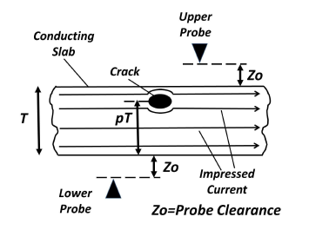
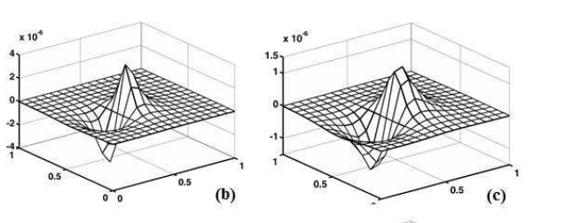
Energy and Non-destructive evaluation
A WAVELET APPROACH FOR THREE DIMENSIONAL CRACK DETECTION IN SLABS USING CURRENT INJECTION PERTURBATION
Method: wavelets approach to crack detection.
it is proposed to use a couple of oppositely arranged field sensor pairs placed above and below the conducting slab. The detection procedure is based on the differential measurement of currents, involving relatively large probes.
Application: location and volume of a 3D embedded crack in a conducting slab of finite thickness.
Top sensor pair measurements
Bottom sensor pair measurements

Slide 10
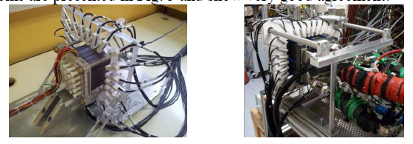
Energy and Non-destructive evaluation
FUEL CELL DIAGNOSIS WITH NEAR MAGNETIC FIELD MEASUREMENTS
Method: non invasive technique for fuel cell diagnosis with reduced number of measurements -> Faster system
The method is based on the measurement of the magnetic field signature generated by a working fuel cell. The current density generating the magnetic field is identified by solving an inverse problem.
Application: estimation of the fuel cell state.
Fuel cell simulator Real fuel cell

Slide 11
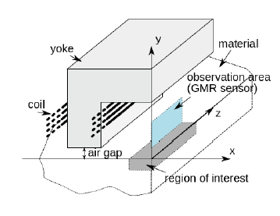
Energy and Non-destructive evaluation
A New Method of Sensitivity Analysis for the Non-destructive Evaluation of Microcracks with GMR Sensors
Method: linking adapted finite element model with adjoint state technique makes it possible to achieve a fast calculation of the sensitivity matrix for a large number of unknowns.
Application: Magnetostatic field measurement using Giant Magnetoresisitive sensors to detect microcracks (up to at least 30 μm depth) in a ferromagnetic material.

Slide 12
Multi-Objective and Evolutionary Optimization Methods
Introduction
Swarm circuits performing optimization and inverse problems | Parameter-free Paretian optimization in electromagnetic: a kinematic formulation | ACTIVE ELECTROMAGNETIC SUSPENSION SYSTEM DESIGN USING HYBRID NEURAL-SWARM OPTIMIZATION
GLOBAL OPTIMIZATION OF A PARALLEL HYBRID ELECTRIC VEHICLE USING OPTIMAL ENERGY MANAGEMENT | RELIABILITY-BASED DESIGN OPTIMIZATION USING LOCAL SENSITIVITY, APPLICATION TO MAGNETIC NANO SWITCH | PARTICLE SWARM OPTIMIZATION AND STRENGTH PARETO TO SOLVE MULTIOBJECTIVE OPTIMIZATION PROBLEMS
BI -OBJECTIVE OPTIMIZATION OF INDUCTION MACHINE USING INTERVAL ANALYSIS | BACTERIAL CHEMOTAXIS SHAPE OPTIMIZATION OF ELECTROMAGNETIC DEVICES

Slide 13
Multi-Objective and Evolutionary Optimization Methods
Swarm circuits performing optimization and inverse problems
Method: an analog swarm circuit is designed that emulates the behavior of swarm-based algorithms. This is done by mathematical translation of the fundamental equations from the numerical to the continuous time-domain. The numerical rules related to swarm algorithms can be interpreted as state equations of an equivalent dynamic analog circuit that reproduces the cinematic characteristics of the trajectories followed by the swarm in terms of voltage and current waveforms.
Application: the swarm circuit has been tested on well-known benchmarks. It opens the road to the optimization and to the solution of inverse problems in hardware implementations in real-time.

Slide 14
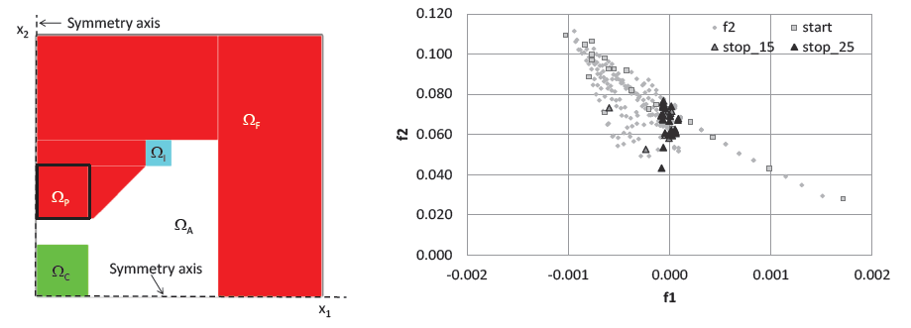
Multi-Objective and Evolutionary Optimization Methods
Parameter-free Paretian optimization in electromagnetic: a kinematic formulation
Method: recently, the unknown boundary of a synthesis region was considered by the authors as a moving boundary under the frame of parameter-free single-objective optimization.
A generalization of the parameter-less kinematic formulation to the multi-objective case is proposed. In particular, a fitness-dependent velocity is defined to update the position of the unknown boundary, eventually exploring the Pareto front of the given optimization problem.
Application: the proposed method was successfully applied to the design of a H-shaped electromagnet for magneto-fluid hyperthermia, and a pancake inductor for heating uniformly a graphite disk.

Slide 15
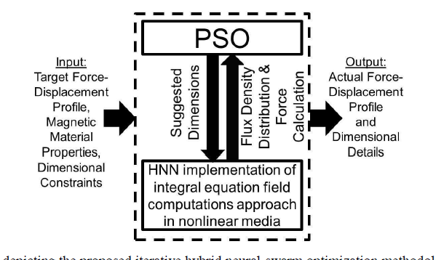
Multi-Objective and Evolutionary Optimization Methods
ACTIVE ELECTROMAGNETIC SUSPENSION SYSTEM DESIGN USING HYBRID NEURAL-SWARM OPTIMIZATION
Method: iterative hybrid neural-swarm optimization method
2D field computations are carried out using the integral equation approach in an automated mechanism through continuous Hopfield neural network (HNN) implementation. Optimal dimensions of the system are identified through the minimization of an error function using the particle swarm optimization (PSO)
Application: electromagnetic suspension system

Slide 16
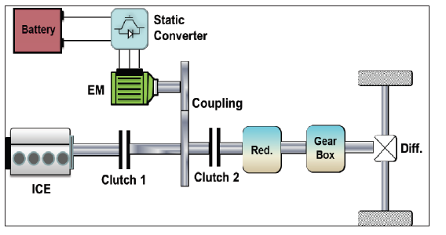
Multi-Objective and Evolutionary Optimization Methods
GLOBAL OPTIMIZATION OF A PARALLEL HYBRID ELECTRIC VEHICLE USING OPTIMAL ENERGY MANAGEMENT
Method: An optimal component sizing process, taking into account the entire system, is proposed based on optimal energy management, in order to minimize the fuel consumption on a driving cycle. This optimization approach of the hybrid electrical vehicle (HEV) uses Radial Basis Function (RBF) models which allow a fast constrained optimization.
Application: Hybrid EV

Slide 17
Multi-Objective and Evolutionary Optimization Methods
RELIABILITY-BASED DESIGN OPTIMIZATION USING LOCAL SENSITIVITY, APPLICATION TO MAGNETIC NANO SWITCH
Method: reliability-based design optimization (RBDO). RBDO aims to minimize a cost function by changing the value of design parameters while ensuring a level of reliability. Correspondingly, a tool based on SQP algorithm using local sensibility by means of automatic differentiation was implemented.
Application: reliable optimization of a magnetic nano-switch.

Slide 18
Multi-Objective and Evolutionary Optimization Methods
PARTICLE SWARM OPTIMIZATION AND STRENGTH PARETO TO SOLVE MULTIOBJECTIVE OPTIMIZATION PROBLEMS
Method: the Strength-Pareto algorithm was incorporated into a Particle Swarm Optimization to build a new approach to solve multiobjective optimization problems.
Application: numerical results validated the proposed method solving the constrained design of a brushless direct current motor in the efficiency vs mass space.

Slide 19
Multi-Objective and Evolutionary Optimization Methods
BI-OBJECTIVE OPTIMIZATION OF INDUCTION MACHINE USING INTERVAL ANALYSIS
Method: two types of algorithms are considered, both amenable to interval analysis. A hybrid algorithm was first considered, which combines the exact interval branch-and-bound and stochastic genetic algorithm; then, an interactive algorithm was proposed, where the possibility to guide the search is granted to the decision maker.
Application: induction machine optimal design in the manufacturing-cost vs total-losses plane.

Slide 20
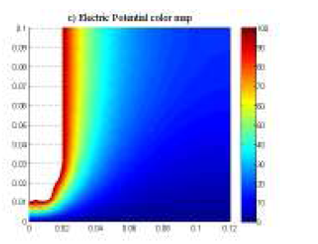
Multi-Objective and Evolutionary Optimization Methods
BACTERIAL CHEMOTAXIS SHAPE OPTIMIZATION OF ELECTROMAGNETIC DEVICES
Method: the bacterial chemotaxis algorithm exploits the conceptual analogy between bacteria and mesh nodes: the design is improved by moving the mesh nodes that define the shape of the device in the same way the bacteria move towards a region offering better life conditions.
Application: the optimal shape of an electrode generating the prescribed field in the inter-electrode region was developed.
Electric potential map of optimized electrode

Slide 21
High frequency applications
Introduction
ALGORITHMIC ISSUES AND EXPERIMENTAL CONSTRAINTS IN ELECTROMAGNETIC INVERSE SCATTERING APPLICATIONS | SPATIAL PATTERN RECONSTRUCTION AND DYNAMIC BEHAVIOR ANALYSIS OF LOW-VOLTAGE ARC BASED ON MAGNETO-OPTIC IMAGING AND AN INVERSE METHOD | ROBUST OPTIMIZATION OF PATCH ANTENNAS FOR UHF-BAND PASSIVE RFID | ESTIMATION OF LAYERED MATERIALS DIELECTRIC PARAMETERS USING PULSED TERAHERTZ TECHNIQUE

Slide 22
High frequency applications
ALGORITHMIC ISSUES AND EXPERIMENTAL CONSTRAINTS IN ELECTROMAGNETIC INVERSE SCATTERING APPLICATIONS
Method/application: the microwave imaging of various targets is designed, specifically: a microwave scanner composed of a metallic cylindrical enclosure, a multiple antennas array and a matching medium in which the antennas and the target under test are immersed. Several types of a-priori information have been considered. Among the different techniques yielding the shape of the scatterer, several sampling methods have been considered, like the MUSIC method, the Linear Sampling Method (LSM) or the Factorization Method (FM).

Slide 23
High frequency applications
SPATIAL PATTERN RECONSTRUCTION AND DYNAMIC BEHAVIOR ANALYSIS OF LOW-VOLTAGE ARC BASED ON MAGNETO-OPTIC IMAGING AND AN INVERSE METHOD
Method/application: a coupled method to reconstruct the arc spatial pattern based on magneto-optic imaging and inverse electromagnetic problem solving is presented. The arc current density reconstruction is obtained by inverting the magnetic field induced by the arc column. In turn, the magnetic field is detected outside the arc breaking set-up based on the Faraday effect. The simulated arc dynamic behavior is compared with results tested by a high-speed camera.

Slide 24
High frequency applications
ROBUST OPTIMIZATION OF PATCH ANTENNAS FOR UHF-BAND PASSIVE RFID
Method: the antenna shape maximizing the input power is identified by means of a µ-genetic algorithm. A moving average filter is used to obtain a robust shape. This results in a patch antenna with a higher output than the conventional patch antenna. When no averaging filter is used, the robustness of the antenna is lower.
Application: RFID is promising for various applications such as environmental sensing and retail management.

Slide 25
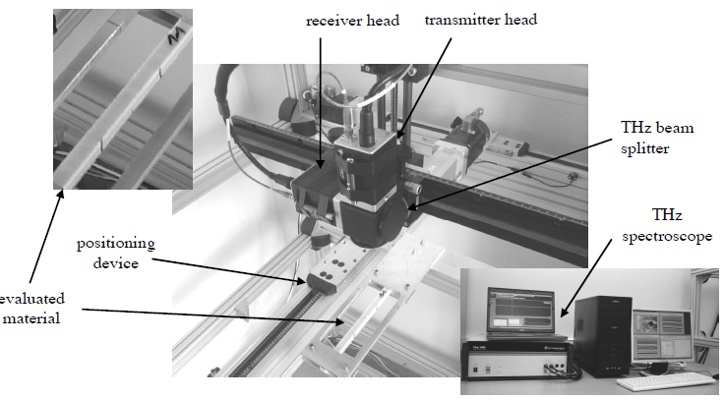
High frequency applications
ESTIMATION OF LAYERED MATERIALS DIELECTRIC PARAMETERS USING PULSED TERAHERTZ TECHNIQUE
Method/application: Pulsed terahertz imaging is a very effective tool in nondestructive evaluation of layered composite materials. An experiment and an inverse scheme based on numerical model and hybrid optimization algorithm are presented in order to identify dielectric parameters or profile of layered composite structures.

Slide 26
Fundamentals and mathematical analysis
Introduction
THE DYNAMICAL INVERSE PROBLEM FOR THE MAXWELL SYSTEM IN TIME-OPTIMAL SETUP | MODEL ORDER REDUCTION OF ELECTROMAGNETIC FIELD PROBLEM COUPLED WITH ELECTRIC CIRCUIT BASED ON PROPER ORTHOGONAL DECOMPOSITION | USE OF COMPENSATION THEOREM FOR THE ROBUSTNESS ASSESSMENT OF ELECTROMAGNETIC DEVICES OPTIMAL DESIGN | OPTIMIZATION OF COILS FOR FIELD MAP SYNTHESIS

Slide 27
Fundamentals and mathematical analysis
THE DYNAMICAL INVERSE PROBLEM FOR THE MAXWELL SYSTEM IN TIME-OPTIMAL SETUP
Method/application: the boundary control method is used to recover the unknown scalar electric permittivity and magnetic permeability of an arbitrarily bounded domain. The supplementary condition comes from field measurements on the boundary of the domain.

Slide 28
Fundamentals and mathematical analysis
MODEL ORDER REDUCTION OF ELECTROMAGNETIC FIELD PROBLEM COUPLED WITH ELECTRIC CIRCUIT BASED ON PROPER ORTHOGONAL DECOMPOSITION
Method: the Proper Orthogonal Decomposition method is applied to reduce the size of the discretized problem. This approach is used to solve a quasistatic problem and a magnetostatic problem coupled with an electric circuit in two dimensions.
Applications: conducting plate subject to a magnetic field originated by a stranded inductor, single-phase transformer supplied with a sinusoidal voltage.

Slide 29
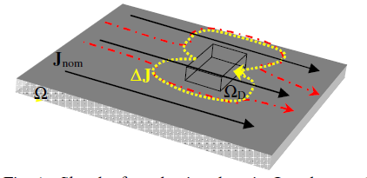
Fundamentals and mathematical analysis
USE OF COMPENSATION THEOREM FOR THE ROBUSTNESS ASSESSMENT OF ELECTROMAGNETIC DEVICES OPTIMAL DESIGN
Method: the classical compensation theorem of circuit theory has been revisited as a tool for robust optimal design and tolerance analysis in linear electromagnetic systems.
Application: the error fields due to currents induced in Tokamak conducting structures was considered. The computed current density has been used to estimate “compensation current” into square holes of different size.

Slide 30
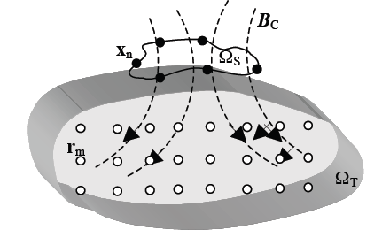
Fundamentals and mathematical analysis
OPTIMIZATION OF COILS FOR FIELD MAP SYNTHESIS
Method: a procedure for the optimization of shape and current supply of active coils is proposed, able to generate a prescribed magnetostatic field within a volume of interest. For the sake of generality, the coil geometry is a filament described by just a reduced set of key points. In addition to the main objective function (field discrepancy), a secondary objective is defined in terms of the length of the spline curve interpolating the coil geometry.
Application: test case consisting of 2 elliptical coils

Slide 31
Optimization and stochastic models
Introduction
STOCHASTIC RESPONSE SURFACE METHOD FOR DIMENSIONING ACCELERATOR CAVITIES | ADAPTIVE UNSCENTED TRANSFORM FOR UNCERTAINTY QUANTIFICATION IN EMC LARGE-SCALE SYSTEMS | STOCHASTIC MODELING OF ANHYSTERETIC MAGNETIC CURVE USING RANDOM INTER-DEPENDENT COEFFICIENTS
INVERSE STOCHASTIC PROPAGATION WITH POLYNOMIAL CHAOS | COMPARISON OF PHYSICAL AND NON-PHYSICAL STOCHASTIC MAGNETISATION FAULT APPROACHES | STOCHASTIC MODELING ERROR REDUCTION USING BAYESIAN APPROACH COUPLED WITH AN ADAPTIVE KRIGING BASED MODEL

Slide 32
Optimization and stochastic models
STOCHASTIC RESPONSE SURFACE METHOD FOR DIMENSIONING ACCELERATOR CAVITIES
Method: a stochastic response surface model was used to represent the dependence of the eigenfrequencies of a superconductive cavity on its geometry. The model is based on both information on the eigenfrequencies as on their sensitivities with respect to the geometry.
Application: microphoning and Lorentz detuning (frequency shifts due to externally or internally induced mechanical deformation).

Slide 33
Optimization and stochastic models
ADAPTIVE UNSCENTED TRANSFORM FOR UNCERTAINTY QUANTIFICATION IN EMC LARGE-SCALE SYSTEMS
Method: the Unscented Transform (UT) is a stochastic collocation method used for uncertainty quantification in nonlinear systems. The method is particularly interesting for EMC models with high-fidelity simulations which are time-consuming, since it demands only a few runs of the electromagnetic solver. However, the method is unpractical for large-scale systems, since the number of simulations required by the UT increases exponentially with the space dimension. An adaptive Unscented Transform was proposed for modeling uncertainties in large dimensional systems.

Slide 34
Optimization and stochastic models
STOCHASTIC MODELING OF ANHYSTERETIC MAGNETIC CURVE USING RANDOM INTER-DEPENDENT COEFFICIENTS
Method/application: a stochastic model of the input parameters of a magnetic system was developed, with reference to the magnetization curve of a laminated material used in electrical machines. The probabilistic model identified was subsequently tested using a Monte Carlo simulation.

Slide 35
Optimization and stochastic models
INVERSE STOCHASTIC PROPAGATION WITH POLYNOMIAL CHAOS
Method/application: a method based on polynomial chaos was presented in order to quantify the impact of stochastic parameters on the inverse solutions of a field problem. A mathematical analysis of the method and a validation onto analytical models was provided. The presented method is valid for any given measurement or objective, resulting in a time effective method for the solution of inverse problems with stochastic parameters in the forward model.

Slide 36
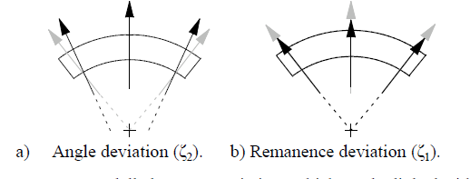
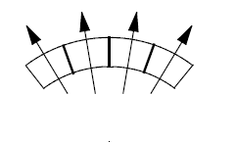
Optimization and stochastic models
COMPARISON OF PHYSICAL AND NON-PHYSICAL STOCHASTIC MAGNETISATION FAULT APPROACHES
Method: the introduction of stochastic deviations due to production faults into the finite element (FE) simulation of electrical machines requires suitable error models, describing the occurring deviations from the ideal case. This paper presents and compares two magnetisation-fault approaches to map measured magnet data into a stochastic FE model. The goal is to improve the simulation of data deviation.
Production-based model
Segmented-magnetization model

Slide 37
Optimization and stochastic models
STOCHASTIC MODELING ERROR REDUCTION USING BAYESIAN APPROACH COUPLED WITH AN ADAPTIVE KRIGING BASED MODEL
Method/application: an adaptive Kriging based model was used to simulate a general electromagnetic device. The accuracy of this ‘coarse’ model was a priori assessed using the cross-validation technique. Moreover, the Bayesian approximation error approach was used for improving the inverse problem results by compensating the modeling errors. The proposed methodology was validated on both purely numerical and real experimental results. The results have shown a significant reduction in the recovery error within an acceptable computational time.

Slide 38
Applications in electrical machines & shielding
Introduction
AUTONOMOUS AND IMPLANTABLE TOTAL ARTIFICIAL HEARTS – POTENTIAL OF NUMERICAL OPTIMIZATION IN THE DEVELOPMENT OF MEDICAL DRIVE SYSTEMS | MULTI-PHYSICS OPTIMIZATION OF AN ENERGY HARVESTER DEVICE FOR AUTOMOTIVE APPLICATION | TOPOLOGICAL OPTIMIZATION OF MAGNETIC SHIELDING BY MEANS OF MULTISTEP EVOLUTIONARY ALGORITHMS WITH ADDITIONAL SEARCH IN RESTRICTED DESIGN SPACE

Slide 39
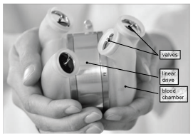
Applications in electrical machines & shielding
AUTONOMOUS AND IMPLANTABLE TOTAL ARTIFICIAL HEARTS – POTENTIAL OF NUMERICAL OPTIMIZATION IN THE DEVELOPMENT OF MEDICAL DRIVE SYSTEMS
Method: the drive of a Totally Artificial Heart (TAH) is optimized in such a way, that the required force is provided, while the resulting losses are in the prescribed range and the weight is as low as possible. Finite Element Analysis (FEA) is applied to determine the magnetic flux density in the drive. The optimization is achieved by applying a parameter variation.
Application: implantable artificial heart.

Slide 40
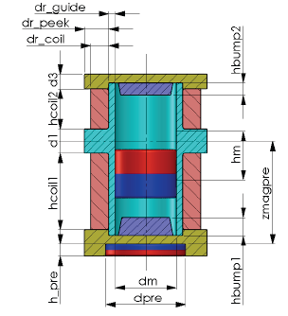
Applications in electrical machines & shielding
MULTI-PHYSICS OPTIMIZATION OF AN ENERGY HARVESTER DEVICE FOR AUTOMOTIVE APPLICATION
Method: Pattern Search algorithm with multi-start strategy
The optimal shape design of an energy harvesting device is developed. The objective function, to be maximized, is the continuous power extracted from the harvester and transferred to an adapted load, mainly at low vehicle velocity values.
Application: energy harvester for automotive, placed in the tyres of the vehicle.

Slide 41
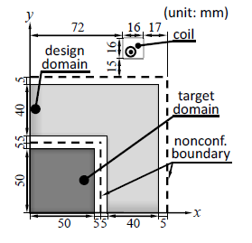
Applications in electrical machines & shielding
TOPOLOGICAL OPTIMIZATION OF MAGNETIC SHIELDING BY MEANS OF MULTISTEP EVOLUTIONARY ALGORITHMS WITH ADDITIONAL SEARCH IN RESTRICTED DESIGN SPACE
Method: topological optimization using the discrete 0-1 information of a magnetic material in finite elements is a method used for the conceptual design of electrical machines. A topological optimization method, based on a multistep genetic algorithm with additional search in restricted design space, was developed.
Application: effective multi-layered magnetic shielding that reduces the magnetic flux density in the target region.

Slide 42
Biomedical applications
Introduction
MAGNETO-PNEUMOGRAPHY – REAL-WORLD PHANTOM INVERSION | A STRATEGY FOR AC-SUSCEPTIBILITY TOMOGRAPHY OF MAGNETIC NANOPARTICLES IN BIOLOGICAL TISSUE | ON EFFECT OF SKULL CONDUCTIVITY ON LINEAR INVERSE PROBLEM OF ELECTROENCE-PHALOGRAPHY | NUMERICAL STUDY ON IC-MREIT WITH MULTIPLE GRADIENT ECHO SEQUENCES FOR THE CONDUCTIVITY ESTIMATION OF BRAIN TISSUES

Slide 43
Biomedical applications
MAGNETOPNEUMOGRAPHY – REAL-WORLD PHANTOM INVERSION
Method: magnetopneumography needs the inversion of a weak magnetic field, measured by means of fluxgate sensors, in order to estimate amount and spatial distribution of ferromagnetic dusts deposited in the lungs of workers in a metal industry. The experimental setup is able to detect remanent fields of small amounts (<8 mg) of magnetite dust.
Application: the identification of dust distribution in a simplified phantom, based on calibration inverse matrix calculated by means of SVD, is presented.

Slide 44
Biomedical applications
A STRATEGY FOR AC-SUSCEPTIBILITY TOMOGRAPHY OF MAGNETIC NANOPARTICLES IN BIOLOGICAL TISSUE
Method/application: non-invasive method to identify the distribution of MNP injected in a biological tissue. The method is based on AC susceptibility measurements using multiple sensors and sequentially switched magnetization fields. It is shown how the contributions of tissue background and magnetic nanoparticles can be separated when different excitation frequencies are employed.

Slide 45
Biomedical applications
ON EFFECT OF SKULL CONDUCTIVITY ON LINEAR INVERSE PROBLEM OF ELECTROENCEPHALOGRAPHY
Method/application: the effect of modeling errors of skull conductivity on EEG source localization is assessed in a 3-layer head model with resolution analysis of linear estimators. The results show that the minimum-norm estimator is rather insensitive to the conductivity error.

Slide 46
Biomedical applications
NUMERICAL STUDY ON IC-MREIT WITH MULTIPLE GRADIENT ECHO SEQUENCES FOR THE CONDUCTIVITY ESTIMATION OF BRAIN TISSUES
Method: the induced current - magnetic resonance electrical impedance tomography (IC-MREIT) with multiple gradient echo sequences is simulated in a segmented head model. This way the frequency-dependent tissue conductivity can be identified.
Application: the conductivities of a spherical head model with four tissues were reconstructed.

Slide 47
Conclusion 1
Most papers were focused on the accuracy vs cost conflict
Sometimes field-based models (in particular FEA) are overlooked, while (semi)analytical models or circuit models are overemphasized
Coupled-field problems (multiphysics) are not yet extensively used as they might be
Non-Destructive-Evalutaion related problems have a long-lasting background, the risk of re-inventing known solutions is high (state-of-the-art is often overlooked)
The propagation of data uncertainty in forward and inverse models is an emerging new topic

Slide 48
Conclusion 2
System-level optimization is going to be a mature topic also thanks to the workshop past editions (Wiley monograph authored by the French group: Integrated Design by Optimization of Electrical Systems)
Biomedical applications related topics are worth to be extended
.....
More general oral contributions would be appreciated
Discussions should be more exhaustive and contributed (OIPE is a workshop...)
Panel discussions in the future ?

